Slide 1
Analysis of NREGA Data
Evaluating the Implementation and Impact of the National Rural Employment Guarantee Act
BY
NAMRATA SALVI
BATCH NAME: MIP – DA – 09

Slide 2
Introduction
Overview of NREGA Purpose:
Alleviate rural unemployment and poverty
Guarantee: Wage employment opportunities for rural households
Project Objective:
Gain insights into the implementation and impact of NREGA
Address key questions related to employment, budget utilization, and regional disparities

Slide 3
Problem Statement
Effectiveness: How effective is NREGA in providing employment opportunities?
Regional Disparities: Are there regional disparities in implementation and outcomes?
Budget Utilization: What is the utilization of the allocated budget, and how does it correlate with employment generation?
Work Completion: What are the key factors contributing to the completion of NREGA works, and are there roadblocks?
Optimization: Can data-driven insights guide policymakers e in optimizing the scheme’s impact?

Slide 4
Dataset Information & Scope of the Project
Source: Official government records
Columns: 28 columns including:
Job cards issued
Workforce details
Budget allocation
Work completion statistics
Expenditure data
Data Preprocessing and Cleaning :Ensure data quality
Exploratory Data Analysis (EDA) :Identify patterns, trends, and disparities
Data Visualization : Present key findings effectively
Actionable Insights : Inform policymakers and administrators about strengths and weaknesses

Slide 5
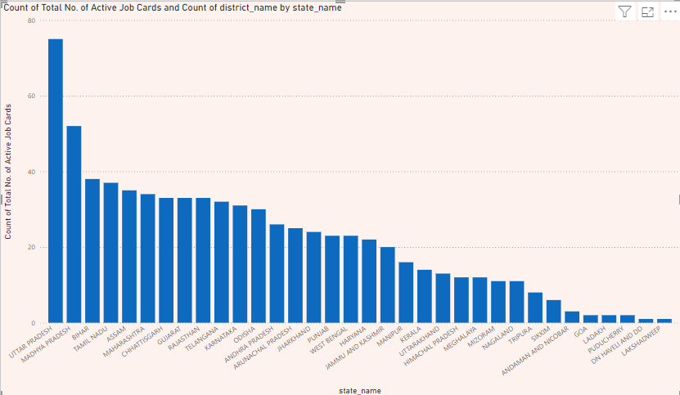
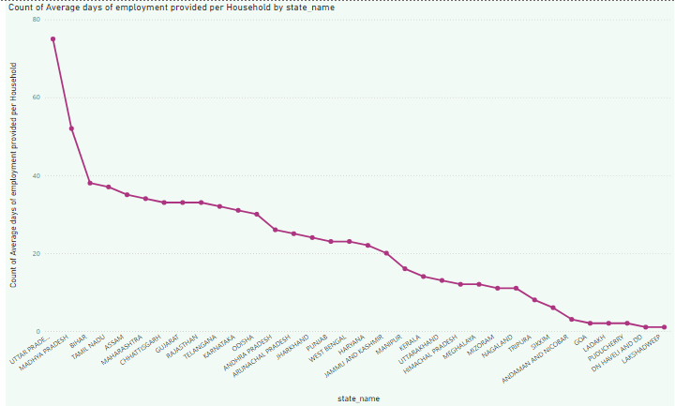
How effective is NREGA in providing employment opportunities to rural households?
Bar Chart for Total Households Worked
Line Chart for Total Individuals Worked over Time

Slide 6
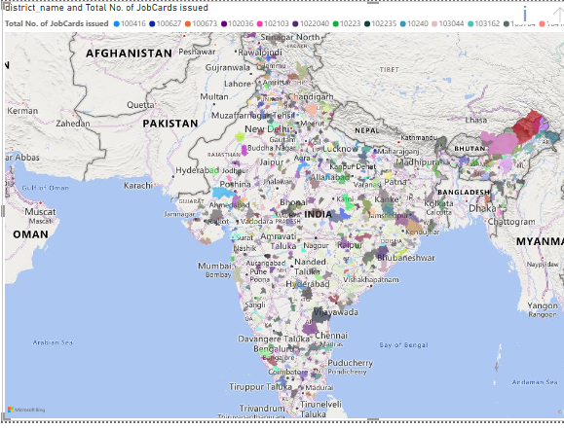
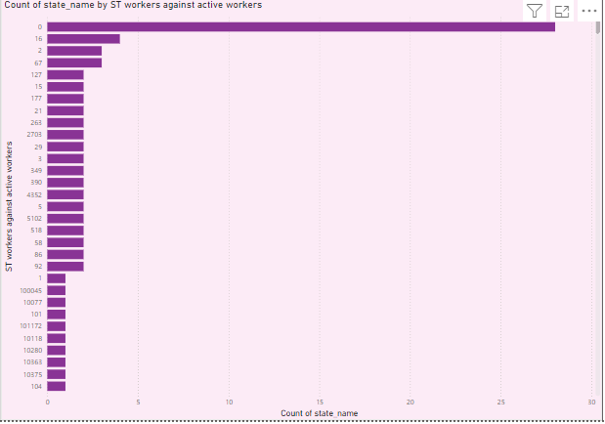
Are there regional disparities in the implementation and outcomes of the scheme?
Choropleth Map for Employment Distribution
Bar Chart for Average Employment Days per Household

Slide 7
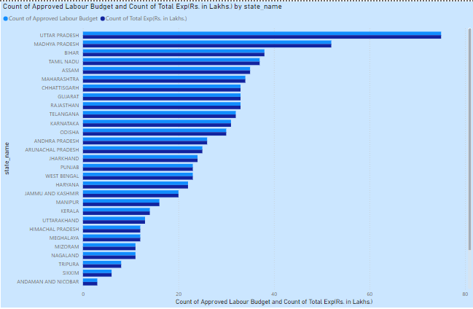
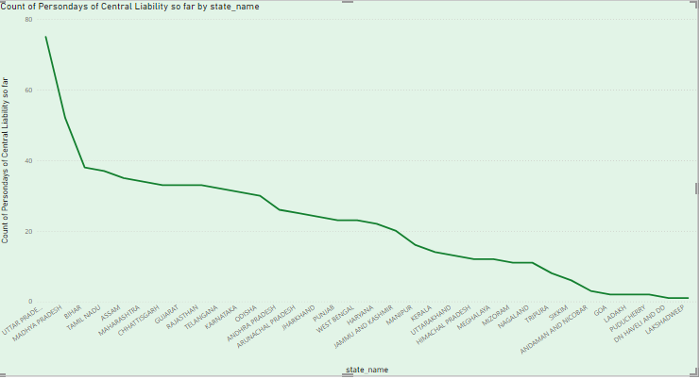
What is the utilization of the allocated budget, and how does it correlate with employment generation?
Clustered Bar Chart for Budget vs. Expenditure
Line Chart for Person days of Central Liability

Slide 8
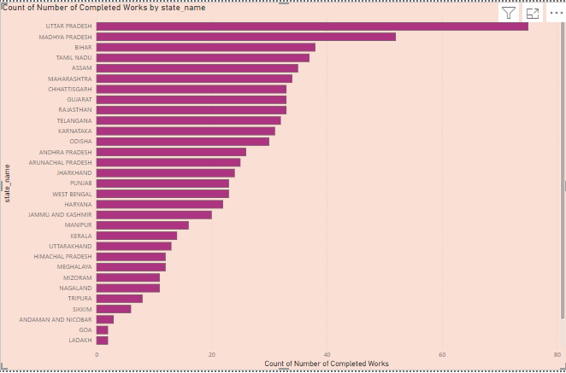
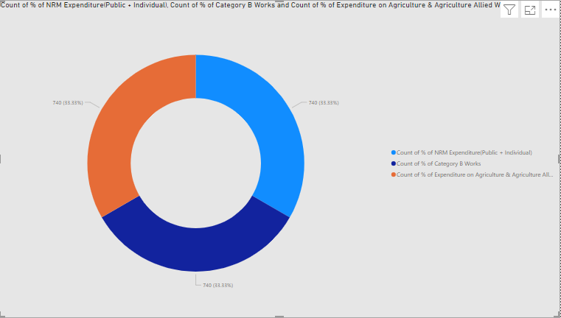
What are the key factors contributing to the completion of NREGA works, and are there any roadblocks to its success?
Bar Chart
X-Axis: State/District Name
Y-Axis: Number of Completed Works, Number of Ongoing Works
Values: % of NRM Expenditure(Public + Individual), % of Category B Works, % of Expenditure on Agriculture & Agriculture Allied Works

Slide 9
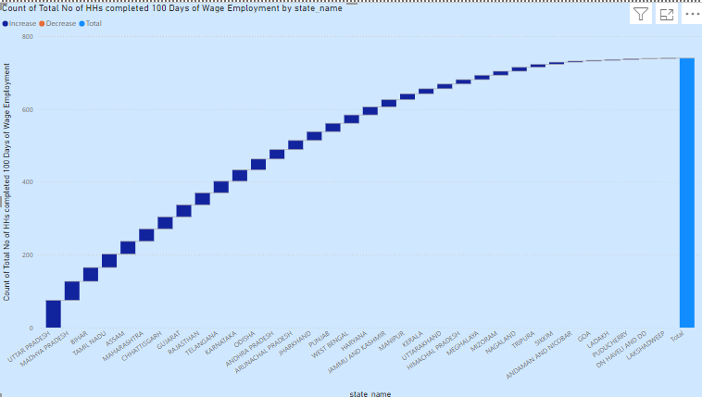
Waterfall Chart
X-Axis: State/District Name
Y-Axis: Total No of HHs completed 100 Days of Wage Employment

Slide 10
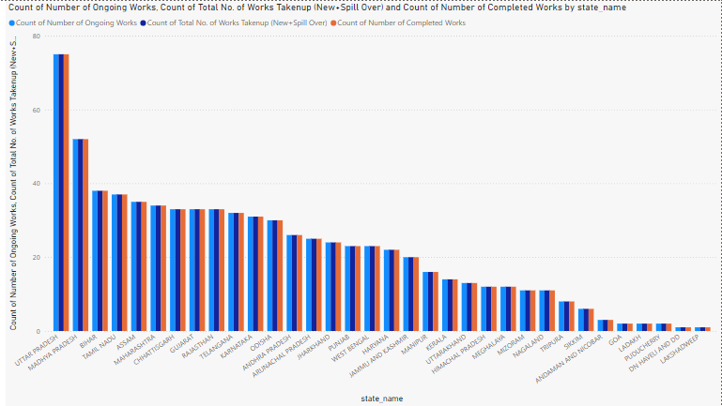
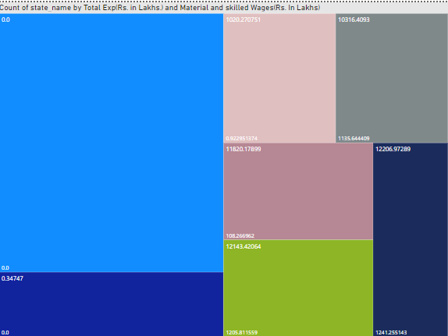
Can data-driven insights guide policymakers and administrators in optimizing the scheme's impact?
Clustered Bar Chart
X-Axis: State/District Name
Y-Axis: Total No. of Works Taken up (New + Spill Over), Number of Ongoing Works, Number of Completed Works
Tree map Categories:
State/District Name
Values: Total Exp (Rs . in Lakhs.), Wages(Rs . In Lakhs), Material and skilled Wages(Rs . In Lakhs), Total Adm Expenditure (Rs. in Lakhs)

Slide 11
THANK YOU!!

